Slide 1



HOME
Real-Time SIEM-Based Cybersecurity Framework for Threat Detection and Prevention in IoMT Environments
25-26J-70
Cyber Security
2026 - 03 - 09

Slide 2



Group Members - Component
UKASHA MMM – IT22904232
Monitoring System
FIRAZ M MN - IT22034304
AI Threat Intelligence Engine
BASHEER MS - IT22031570
Adaptive Incident Correlation Engine
– AICE
AGMK GUNASEKARA - IT22587138
Automated Response System
Supervisor : Mr. Kanishka Yapa
Co – Supervisor : Deemantha Siriwardhana
Cyber Security
25-26J-70
Cyber Security
2026 - 01 - 05
25-26J-70
2026 - 03 - 09

Slide 3
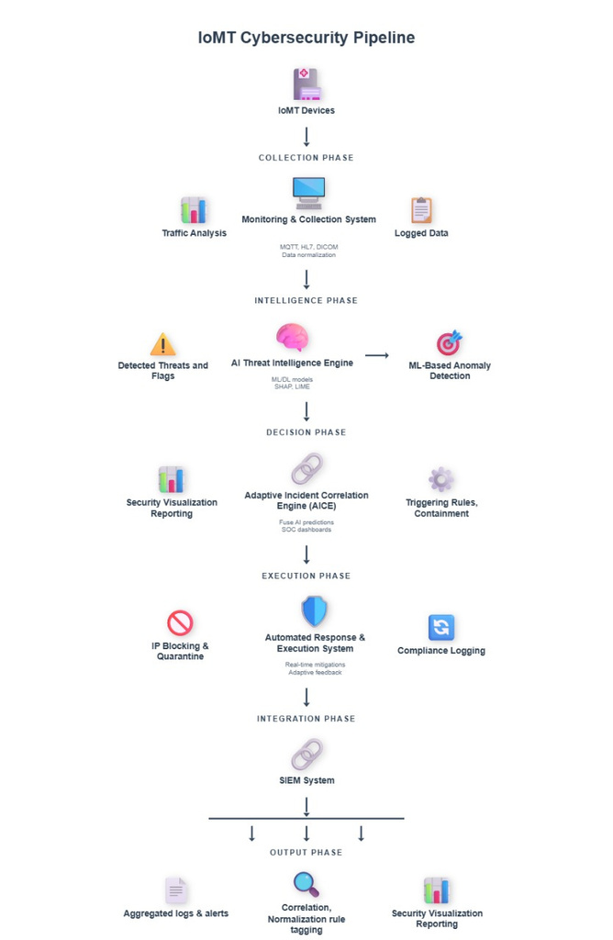
System Diagram
25-26J-70
Cyber Security
2026 – 03 - 09

Slide 4
CONTEXT
Modern hospitals use IoMT (Internet of Medical Things) devices such as:
ECG Monitors
Pulse Sensors
Temperature Sensors
Patient Monitoring Systems
PROBLEM
IoMT networks are vulnerable to cyber attacks , DoS attacks, Malware attacks, Unauthorized access.
25-26J-70
Cyber Security
2026 – 03 - 09

Slide 5
GAP AND MAIN OBJECTIVE
Main Objective
Develop a real-time IoMT-aware SIEM framework that detects cyber threats, reduces alert overload, and prioritizes incidents based on patient safety.
Research GAP
Existing SIEM systems lack IoMT awareness
No clinical impact–based alert prioritization
High alert volume causes SOC overload
No automated response for IoMT threats
25-26J-70
Cyber Security
2026 – 03 - 09

Slide 6
Solution Overview
A lightweight AI-powered SIEM-based cybersecurity framework designed for IoMT hospital environments that detects anomalous device behavior, correlates alerts, and supports automated response to protect patient safety and medical data.
Key Features Delivered
AI Threat Detection Engine Analyzes IoMT network traffic and device logs using machine learning models (Random Forest and Isolation Forest) to detect anomalies and generate threat intelligence.
Intelligent Monitoring & Alert Prioritization Processes IoMT alerts, groups related events, and prioritizes incidents based on device criticality and patient safety impact.
Adaptive Incident Correlation & Automated Response Correlates alerts from AI models and IDS logs to generate actionable incidents and supports automated containment such as device isolation and recovery.
Current Completion Status
IoMT hospital environment simulation created using ESP devices and sensors.
Device logs successfully collected and stored in the database.
Individual machine learning models trained and validated.
System integration between components (Monitoring, AI Engine, AICE, Response) is currently in progress.
Real-time response execution and full SIEM pipeline integration remain pending.
Overall Completion – 80%
25-26J-70
Cyber Security
2026 – 03 - 09

Slide 7
System Architecture
Integration Points (APIs / Data Formats)
WebSocket communication for real-time device data streaming
MQTT protocol for IoMT device communication
WiFi traffic analysis from ESP-based IoMT devices
Data exchange formats: CSV and JSON
MongoDB database used for storing logs, alerts, and device data
Pipeline architecture connecting monitoring → AI detection → correlation → response system
Deployment / Runtime Setup
IoMT Device Layer: ESP controllers and sensors generating device data
Network Layer: WiFi-based communication with MQTT and WebSocket protocols
Processing Layer: AI models and correlation engines running on a central machine/server
Database Layer: MongoDB for log storage and event tracking
System Architecture: Full pipeline integration connecting all components for real-time threat detection and response
Components
Component A – Monitoring System Owner: IT22904232 – MMM Ukasha Responsible for collecting IoMT device logs, monitoring network traffic, and generating prioritized alerts using machine learning–based alert management.
Component B – AI Threat Intelligence Engine Owner: IT22034304 – Firaz M MN Processes IoMT network traffic and device logs using machine learning models (Random Forest, Isolation Forest) to detect anomalies and generate attack probability scores.
Component C – Adaptive Incident Correlation Engine (AICE)
Owner: IT22031570 – Basheer MS Correlates alerts from AI models and IDS systems, assigns severity levels based on device criticality and patient safety, and generates SOC-ready incident summaries.
Component D – Automated Response System (ARS) Owner: IT22587138 – A.G.M.K Gunasekara Executes automated containment actions such as device isolation, PHI redaction, and rollback recovery to protect hospital systems.
25-26J-70
Cyber Security
2026 – 03 - 09

Slide 8
Faced Challenges
System Integration Challenges
Initial architecture planned CSV-based data sharing between components, but this approach is not suitable for real-time processing.
To achieve real-time detection and response, the system must be redesigned using a continuous data pipeline architecture.
IoMT Device Development Challenges
Building ESP-based IoMT devices and sensors for testing the hospital environment required significant hardware configuration.
Generating realistic device logs from medical sensors is complex and time-consuming.
Data Collection & Communication Challenges
Device logs must be collected directly through APIs or endpoints rather than static files.
Implemented MQTT broker communication to stream device data and store it in the MongoDB database.
Component Integration Issues
Components are currently working independently, but full pipeline integration is still under development.
Because of this, the Automated Response System cannot yet trigger real device actions.
Network & Performance Constraints
All IoMT devices must operate within the same local network, which limits scalability.
Processing latency increases due to centralized data processing and multiple system components.
Data Consistency Challenges
Data is received from multiple endpoints and protocols, causing difficulties in:
Data synchronization
Format standardization
Real-time processing
25-26J-70
Cyber Security
2026 – 03 - 09

Slide 9

Commercialization & Real-World Use
Target Users / Market
Sri Lankan hospitals (public and private) using IoMT medical devices
Healthcare IT departments and SOC teams responsible for cybersecurity monitoring
Clinical engineers managing connected medical equipment
Future expansion to South Asian healthcare systems with similar infrastructure constraints
Cost and Feasibility
Uses open-source technologies (Python, ML frameworks)
Estimated development and deployment cost:
Initial prototype: 50,000 – 70,000 LKR
Infrastructure: existing hospital servers or cloud deployment
Low hardware requirements allow deployment on standard hospital IT infrastructure
25-26J-70
Cyber Security
2026 – 03 - 09

Slide 10
Q & A
Real-Time SIEM-Based Cybersecurity Framework for Threat Detection and Prevention in IoMT Environments
25-26J-70
Cyber Security
2026 - 03 - 09

Slide 11

Thank You
Real-Time SIEM-Based Cybersecurity Framework for Threat Detection and Prevention in IoMT Environments
25-26J-70
Cyber Security
2026 - 03 - 09

